Slide 1

Skills & Knowledge Organiser
Reception
Autumn Term 1

Slide 2

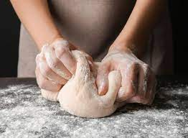
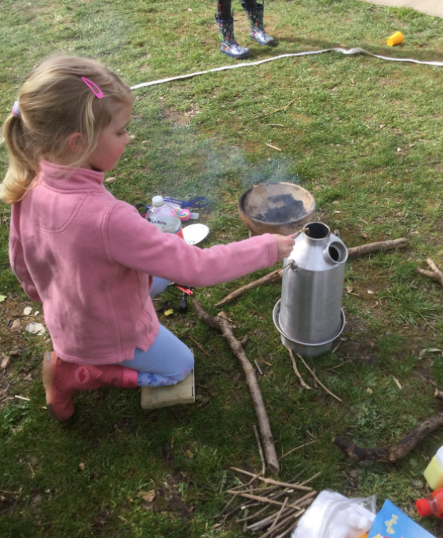




Who Am I?
Autumn Walk
Making Bread
Harvest
Diwali
Wild Tribe
LEARNING Hooks
cultural capital & Enrichment Experiences

Slide 3


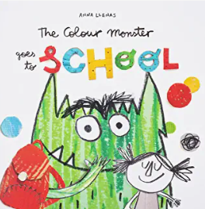







Possible Themes, Interests &
Lines of Enquiry
Notes:
Link to Planning: MTP

Slide 4


Communication and Language
Welcome to Reception
Listening:
Listen to others 1:1, in small groups and whole class.
Enjoy listening to stories and can remember what happens.
Listen carefully to rhymes/ songs, paying attention to how they sound.
Understand how to listen carefully and why listening is important.
Attention:
Maintain attention in whole class and small group contexts for a short time.
May find it difficult to pay attention to more than one thing at a time.
Respond:
Engage in story times.
Join in with repeated refrains and anticipate key events and phases in stories or rhymes.
Respond appropriately when asked e.g. bells = freeze & show me 10
Understanding:
Follow 1 step instructions e.g., put bookbag on your peg..
Understand ‘why’ questions.
Speaking:
Use sentences of 4-6 words.
Sing a large repertoire of songs e.g., nursery rhymes or numbers of songs.
Begin to use social phrases e.g., ‘Good Morning!
Use talk to organise themselves and their play.
Vocabulary Concepts:
where, what, why, who, how, either, or, in front, beside, between, until, while, but, although, above, after, all, around, back/ backwards, before, behind, below, both, different, early, forwards, front, story telling language
Revisit/ ongoing throughout the year
Learn new vocabulary Use new vocabulary in different contexts
Use new vocabulary through the day in discussions and conversations
Learn new rhymes, poems, and songs
Listen to and talk about stories to build
familiarity and understanding
Ideas for home learning:
Play a game of ‘I Spy’ using adjectives (describing words) such as “I spy something coloured red/ blue … or something round/ spikey/ shiny … or something that is big/ beautiful/ smelly/ growing/ hot/ noisy”
Notes:
CL Progression of Skills
Poetry Basket

Slide 5



Personal, Social and Emotional Development
Express feelings:
Aware of own feelings, can talk about feelings using words like ‘happy’, ‘sad’, ‘angry’.
Begin to understand how others might be feeling.
Know they can rely on their teachers, friends, and ‘buddy’ for support if they are worried.
Manage behaviour:
Can inhibit own actions, welcome distractions when upset.
Understand behavioural expectations of the setting.
Increasingly follow rules understanding why they are important.
Self-awareness:
Know what they like and do not like.
Understands there are responsibilities in the classroom to follow and expectations for behaviour.
Independence:
Can independently organise themselves in the morning e.g., bookbag in tray, coat on peg, water bottle on trolley, name card on board.
Can manage their own personal hygiene e.g., toileting. Can follow 1 step instructions.
Collaboration:
Interested in others play and starting to join in.
Knows we work together to follow the class responsibilities
Social skills:
Build constructive and respectful relationships.
Engage in positive interactions with adults and peers.
Play with one or more children, extending and elaborating play ideas.
Vocabulary:
Myself, Feelings, Being gentle, Rights, Talents, Responsibilities, Families, Home, Friends, Challenges, Perseverance, Jobs, Help, Exercise, Healthy food, Physical activity, Sleep, Clean, Bodies,
Respecting my body, Fun, Fears, Growth
Revisit/ ongoing throughout the year
Continue to develop skills of using gestures, non-verbal communication, facial expressions, body language, appropriate language, and vocabulary
Listen to others, speak to peers and adults and engage in discussions in a positive way
Home Learning:
Ask your child to complete a ‘job’ to help your family e.g. make your bed, lay the table, help prepare a meal.
PSHE
Families and People Who Care for Me: Understanding that ‘family’ means different things to different people.
Our rights; Our responsibilities
Notes:
PSED Progression of Skills
Jigsaw

Slide 6




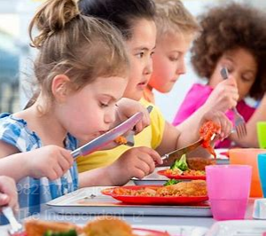
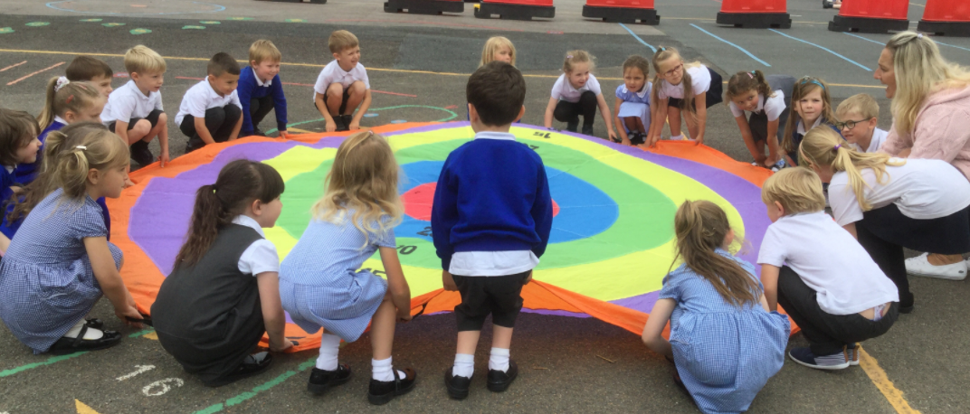

Revisit/ ongoing throughout the year
Continue to develop overall body-strength, balance, coordination, and agility through use of outdoor play equipment.
Physical Development
Develop the skills they need to manage the school day successfully: lining up and queuing, mealtimes, personal hygiene, changing
Develop their small motor skills so that they can use a range of tools competently, safely, and confidently. Suggested tools: pencils for drawing and writing, paintbrushes, scissors, knives, forks, and spoon.
Develop the overall body strength, coordination, balance, and agility needed to engage successfully with future physical education sessions and other physical disciplines including dance, gymnastics, sport, and swimming through cooperation/ parachute games.
Home Learning
Ask your child to practise yoga before bedtime to relax, prepare their eyes
and body for a restful
night sleep.
Vocabulary
Warm up, roll, side step, gallop, hop, skip, space, breathe in/ out, body part names, balance, catch, trap, hold, stop, freeze, cool down, stretch, wide, narrow, long, still
Notes:
PE Progression of Skills

Slide 7



Literacy
Vocabulary: Phoneme, sound, phoneme frame, sound buttons, grapheme, rhyme, print, words, letters, sounds, books, story, blend, segment
Revisit/ ongoing throughout the year
Re-read books to build up their confidence in word reading, their fluency and their understanding and enjoyment. Read books consistent with their phonic knowledge.
Emergent writing:
Develop listening and speaking skills in a range of
contexts.
Aware that writing communicates meaning.
Give meaning to marks they make. Understand that
thoughts can be written down.
Write their name copying it from a name card or try to write it from memory.
Composition:
Use talk to link ideas, clarify thinking and feelings. Understands that thoughts and stories can be written down.
Spelling:
Orally segment sounds in simple words.
Write their name copying it from a name card or try to write it from memory.
Handwriting:
Know that print carries meaning and in English, is read from left to right and top to bottom.
Draws lines and circles.
COMPREHENSION
Listen and enjoy sharing a range of books.
Hold a book correctly, handle with care and turn pages
from front to back and recognise front and back cover.
Know that print carries meaning and in English, is read
from left to right and top to bottom.
Know the difference between text and illustrations.
Enjoy joining in with rhyme, songs, and poems.
Join in with repeated refrains and key phrases.
WORD READING
Hear general sound discrimination and be able to orally blend and segment.
Home Learning:
Ask your child to be a sound detective and look for sounds of the day in some old magazines/newspapers at home
Ask your child to complete their sound sheets
Ask your child to read their decodable book, tuning into focus sounds
Notes:
Reading Progression of Skills
Literacy MTP
Writing Development
Pencil Grip Development
Shared Reading (VIPERS)

Slide 8

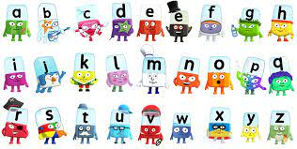
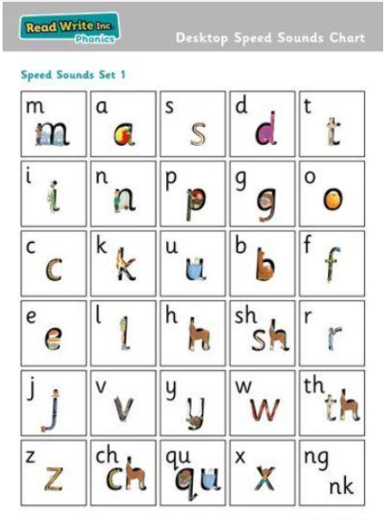
Revisit/ ongoing throughout the year
Continue to develop general sound discrimination, rhythm and rhyme, alliteration, voice sounds, oral blending, and segmenting.
RWI
Read Write Inc (RWInc) is a phonics complete literacy program which helps all children learn to read fluently and at speed so they can focus on developing their skills in comprehension, vocabulary and spelling.
Children will be able to read all single letter set 1 sounds and be able to blend sounds into words orally.
Home Learning
Choose one or two sounds to focus on each day and make some words containing these sounds, ask your child to read the words that you make … are they real or nonsense alien words?
Notes:
Talk for Writing
Essential Phonics

Slide 9
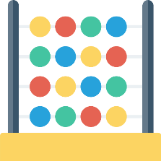





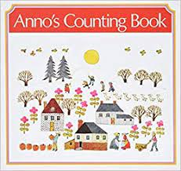
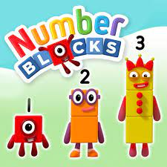



Mathematics Baseline – 3 weeks: Opportunity to settle in, intro the areas of provision inside and outside and get to know the
children’s mathematical knowledge through play, intro key times of day, class routines, where do things belong? [Positional language]
Vocabulary:
Number, zero, one, two, three ..... to ten, none, How many? is the same as, equals, balances, as many as
more, larger, bigger, greater, biggest, most, less, fewer, smaller, smallest, least, guess, nearly, close to, about, just over, just under, too many, too few, enough, not enough
Count objects, actions, and sounds
Subitise
Matching - same/different, colour, size, shape
Sorting into groups
Counting by rote, counting aloud, clapping, stamping, drumming etc, nursery rhymes, counting songs, using fingers to represent numbers
Comparing amounts – equal, more than, fewer than.
Comparing size, mass & capacity – big/little, large/small, short/tall, tallest/shortest
Exploring pattern - making simple patterns, odd one out, exploring more complex patterns.
Home Learning:
• Use number tracks in games (ensure there is variation e.g. horizontal, vertical, diagonal, ascending value and descending value)
• Sing number rhymes together (ten green bottles, ten fat sausages, 1 2 3 4 5 once I caught a fish alive, five speckled frogs etc.)
• Create number books with your child e.g. ‘My book of 6’ and taking photographs, stamping numbers and objects in.
Notes:
Mathematics Progression of Skills
STEM Sentence Progression
White Rose Maths SOL
Key Skills

Slide 10




Understanding the World
Vocabulary:
Family, special, people, mum, dad, step-mum, step-dad, grandma, grandpa, brother, sister, friend, relative, aunt, uncle, cousin, baby, guardian, parent, carer.
Revisit/ ongoing throughout the year
Communication: Comment on what they notice about the environment where they live and understand the effect of the changing seasons on the natural world around them. Describe what they see, hear, and feel outside.
Observation: Explore the natural world around them by making observations and drawing pictures of animals and plants. Understand the need to respect and care for the natural environment and all living things.
Chronology:
Talk about members of their immediate family and the relationship to them, name and describe people who are familiar to them.
Begin to develop a sense of continuity and change by being able to compare characters from stories.
Respect
Themselves, special things in their own lives. Talk about and describe features of their own family, talk about families in other countries across the world.
Mapping:
Talk about the features of their immediate environment with visual representations e.g., classroom maps, Pete’s story map around school, seating maps, wildlife area map and read common signs and logos.
Home Learning:
• Talk to your child about what makes them special. We are all different: Each person has their own particular likes and dislikes, their favourites and their talents (special things they can do).
• Look at a photographs of each family member as a baby. Discuss how they are all different, that’s what makes us special!
Notes:
UtW Progression of Skills: Past&Present [History], Geography, Natural World [Science], OE, People, Culture&Communities [RE], Computing
UtW Lesson Plans & Links

Slide 11
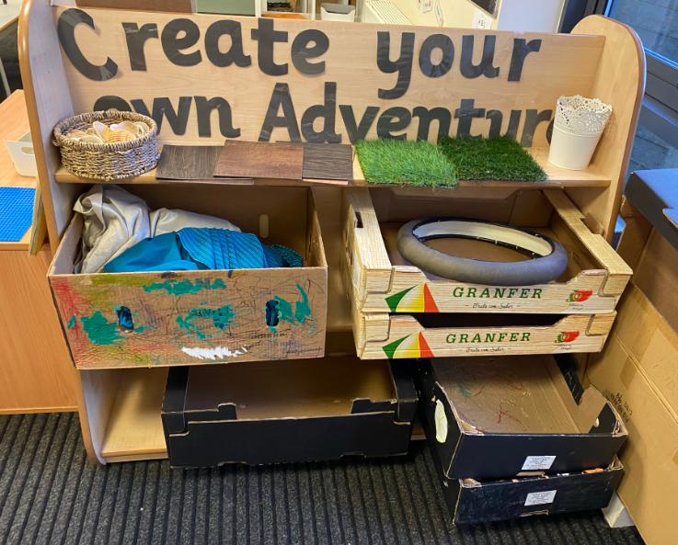




Expressive Arts and Design
Join in with role play games and use resources available for props; build models using construction equipment.
Sing call-and-response songs.
Self-portraits
Exploring sounds and how they can be changed, tapping out of simple rhythms.
Provide opportunities to work together to develop and realise creative ideas. Develop storylines in their pretend play.
Artist study – Jackson Pollock (collaborative work)
Refer to Art and design progression map to facilitate progression through child led interests.
Vocabulary
Thick, thin, soft, pattern, line, shape, detail, charcoal coloured pencil, felt tip pen, primary (colour), light, dark, warm, cold, bright, glue stick, scissors, thread, model, cut, stick, fold, bend, attach, assemble, join, press, poke, squeeze, roll, stack, pinch
Revisit/ ongoing throughout the year
Explore, use, and refine a variety of artistic effects to express their ideas and feelings.
Explore and engage in music making and dance, performing solo or in groups.
Charanga Songs:
Pat-a-cake
1, 2, 3, 4, 5, Once I Caught a Fish Alive
This Old Man
Five Little Ducks
Name Song
Things For Fingers
Notes:
Art & Design Progression of Skills
Music Progression of Skills
EAD Lesson Plans & Links

Slide 12



Developing curiosity…
• What did you do in school that was new today?
• Who did you meet today?
• Can you learn the names of the children in your class?
Big Question

